Slide 1
COLOR BASED PRODUCT SORTING
L.DANIEL (950322106005)
G.JOEL RAJ (950322106008)
V.SAKTHI RAJA(950322106012)

Slide 2
OBJECTIVES
Detect and identify object colors using a color sensor.
Automatically sort objects using servo motors.
Display sorting details on an LCD screen.
Improve efficiency in automated sorting systems.

Slide 3
Abstract
This project is an automated color sorting system using a TCS3200 color sensor.
The system detects an object's color, displays it on an LCD, and sorts it using servo motors.
A conveyor belt moves objects to the sorting position.
This system enhances efficiency in industrial and waste management applications.

Slide 4
Literature survey
PAPER TITLE | AUTHORS | METHODOLOGY | DRAWBACKS
Sensor-based color sorting system using conveyor system | Md. Mostafizur Rohman Komol | Conveyor belt and color detection technology | Limited color detection, mechanical limitations
Color sensor-based optical sorting machine | Timothy Henry | Color-based product sorting using a color sensor | Inconsistent sensor settings
Design a product separating conveyor based on color | Malathy Jawahar | Color sorting by image processing technology | Processing time, limited accuracy

Slide 5
PAPER TITLE | AUTHORS | METHODOLOGY | DRAWBACKS
Colorimetric sensor array for soft drinks analysis | C. Zhang and K. S. Suslick | Used an array of color sensors to detect flavor and freshness in soft drinks. | Limited to liquid samples and may not perform well with carbonated beverages.
Color measurement of a solid active pharmaceutical ingredient as an aid to identifying key process parameters | P. D. Oram and J. Strine, | Used real-time color monitoring to ensure process consistency in drug manufacturing. | Affected by lighting conditions and surface texture of the sample.
High- speed industrial color and position sensors | M. Frank, Nobert Kaiser, Wolfgang Buss, Ramona Eberhardt, | Implemented fast color sensors with integrated position tracking in automation lines. | High cost and complexity in calibration for different materials
E. J. Cadieux Jr, | System and method for visually inspecting a cigarette packaging process | Employed vision systems to detect color and print defects in cigarette packaging. | Limited performance under poor lighting or high-speed operations.

Slide 6
PAPER TITLE | AUTHORS | METHODOLOGY | DRAWBACKS
Application of colors sensor in an automated system | Norfazlinda Binti Daud | Used color sensors in an automation system to classify products based on surface color. | Limited accuracy under variable lighting conditions.
Automated Color-Sorting uses optical technology | Bickman, Josh, | Employed optical sensors and microcontrollers for real-time color-based sorting | May misclassify closely related colors or reflective materials.
Visual processing and classification of items on a moving conveyor: a selective perception approach | Bozma and Yal-cin | Used visual algorithms for real-time classification of objects on a conveyor. | Complex algorithms require high processing power and calibration.
Ceramic tile inspection for color and structural deffects | C Boukouvalas, J Kittler, R Marik | Used machine vision to inspect color consistency and detect defects in tiles. | Sensitive to tile orientation and lighting variance.
Sorting of items on a moving conveyor belt | R Mattone, G. Campagiorni, F. Galati | Designed a vision-based system to detect and sort moving items by color. | Motion blur and speed inconsistencies affect accuracy.

Slide 7
METHODOLOGY
Object Detection & Color Sensing – TCS3200 color sensor detects object color
Sorting Mechanism & Display – Displays detected color and activates the corresponding servo motor.
Conveyor Belt – Conveyor moves objects.
Automated Sorting – Servo moves object to the respective side (right or left) for sorting.

Slide 8
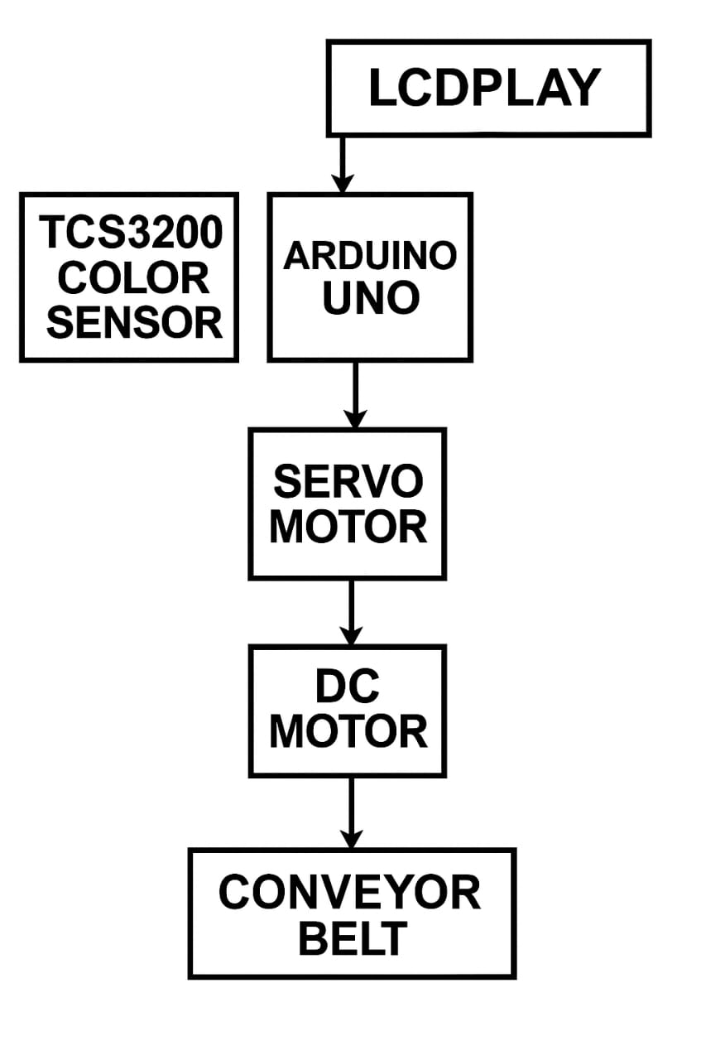
block DAIGRAM

Slide 9
COMPONENTS
HARDWARE COMPONENTS
1. Arduino UNO
2.TCS3200 Color Sensor
3.DC Motor
4.Servo Motor (x2)
5.16x2 LCD Display (with I2C module)

Slide 10
SOFTWARE
Arduino IDE
The official software used to write, compile, and upload code to the Arduino Uno board. It supports
C/C++ based coding and provides an easy interface for microcontroller programming.

Slide 11
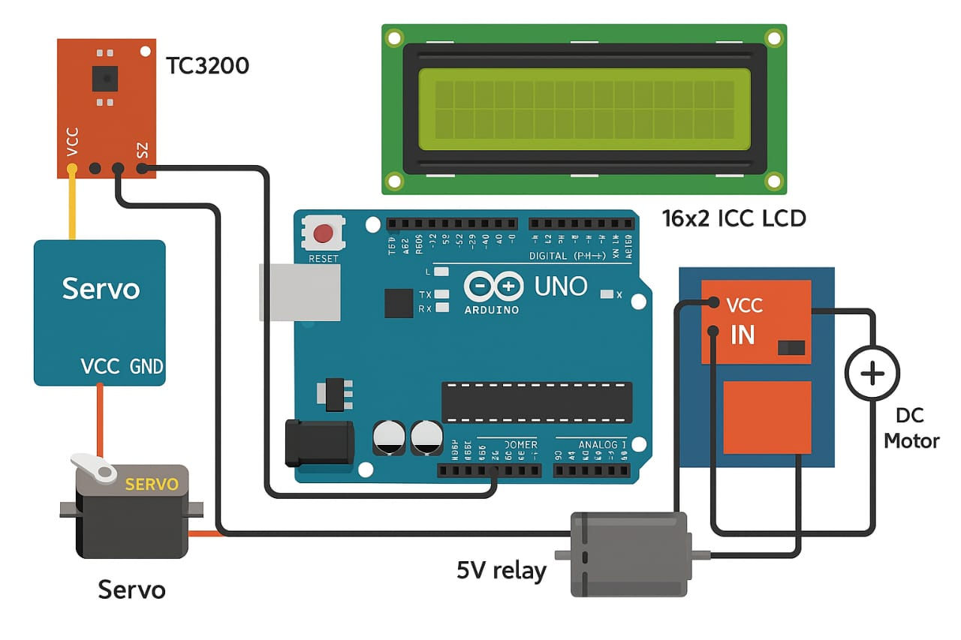
CRICUIT DIAGRAM

Slide 12
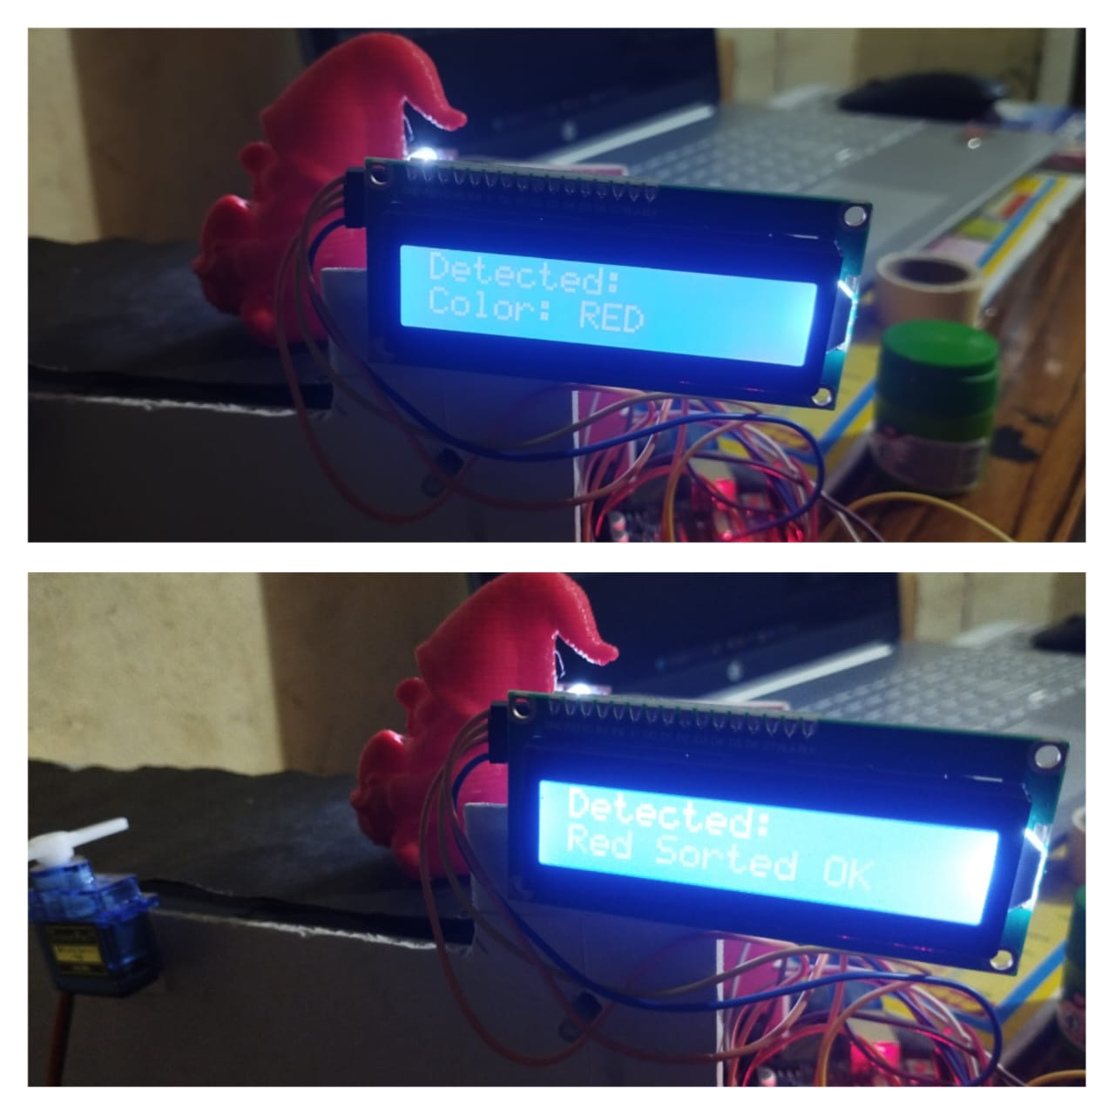
OUTPUT
Detecting colour red and display the product is sorted

Slide 13
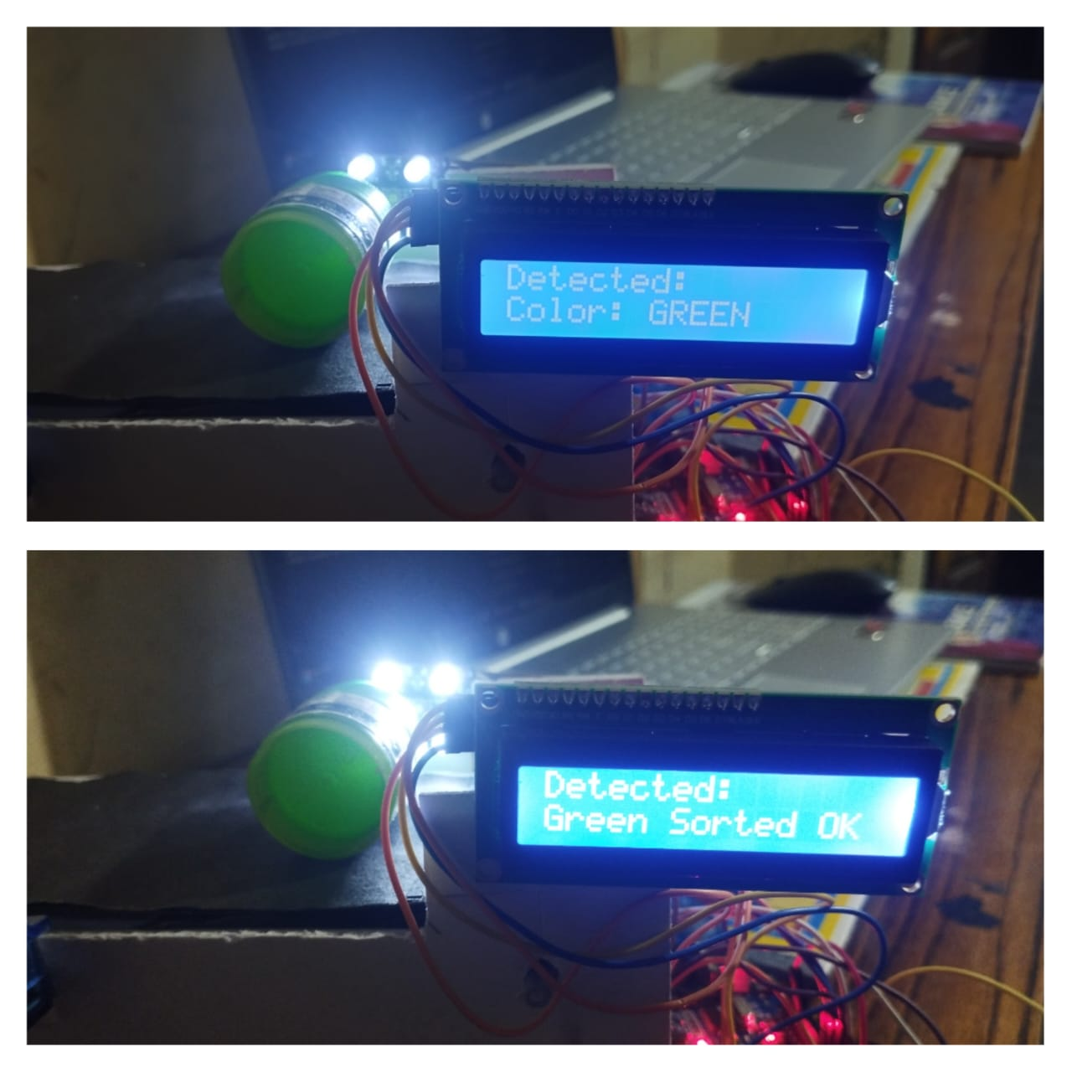
OUTPUT
Detecting colour green and display the product is sorted

Slide 14
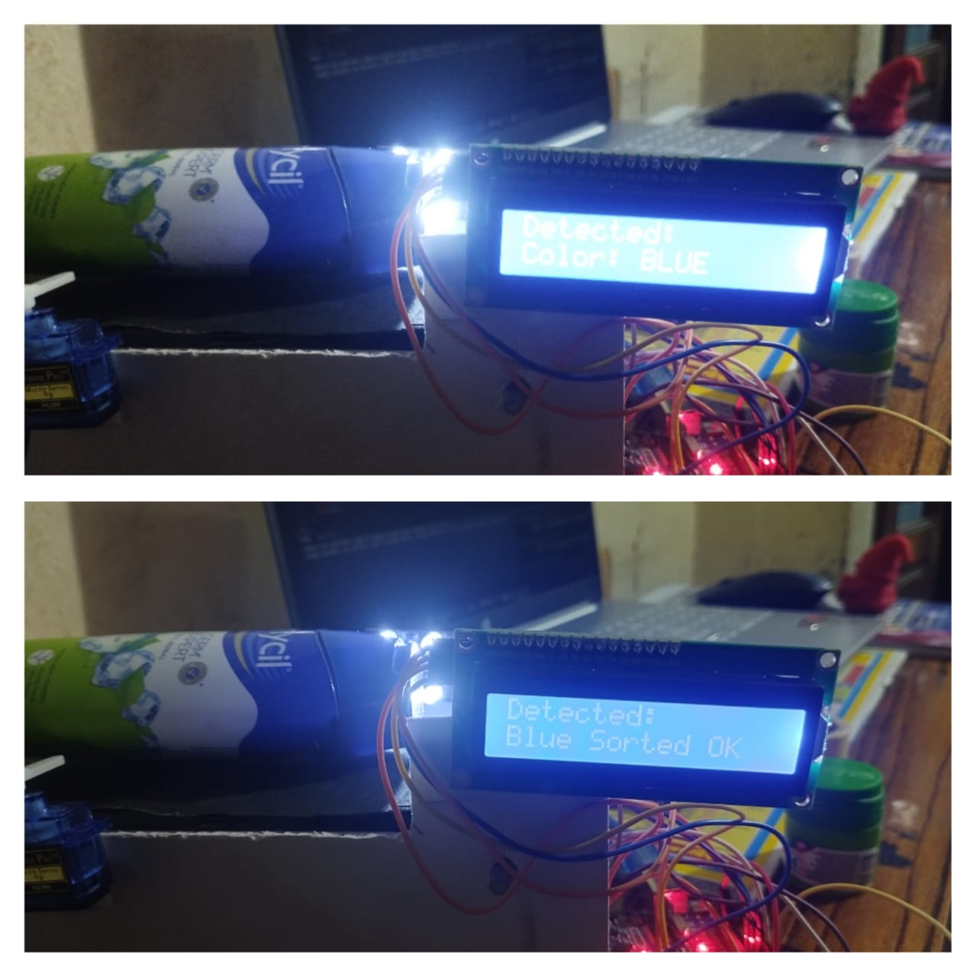
OUTPUT
Detecting colour blue and display the product is sorted

Slide 15
FUTURE SCOPE
In the future, this color sorting system can be enhanced by incorporating additional sensors to detect a wider range of colors and improve accuracy. Using more servo motors or robotic arms could allow sorting of more colors, such as yellow and orange, or even multiple objects simultaneously for higher efficiency. Integrating wireless communication or IoT features would enable remote monitoring and control, making the system more versatile for industrial applications. Furthermore, implementing machine learning algorithms could improve color recognition under varying lighting conditions and object shapes, making the sorter more adaptive and reliable in real-world environments. Lastly, scaling up the system with conveyor belts and automatic object feeding mechanisms could transform this project into a fully automated sorting line.

Slide 16
CONCLUSION
The color sorting system was successfully developed using the TCS3200 color sensor and two servo motors, controlled by an Arduino board. The sensor accurately detects the primary colors—red, green, and blue—based on light frequency values. Once a color is identified, the Arduino triggers the appropriate servo motor to sort the object into its designated position. One servo motor is dedicated to sorting green objects, while the second servo handles both red and blue objects by moving to specific angles for each color. The system also includes an I2C LCD display that shows the detected color and sorting status in real-time, enhancing user interaction. This project demonstrates a simple yet effective method for color-based object classification, offering a practical application in automation, recycling, and learning environments.

Slide 17
REFERENCE
[1] R. Bogue, “Optical chemical sensors for industrial applications”, 2007.
[2] Malathy Jawahar “Sensor based Color Sorting System for leather shoe components” 2017
[3] Timothy Henry “Design and Construction of Color Sensor Based Optical Sorting Machine “ 2015
[4] Md. Mostafizur Rahman Komol “Design and Construction of Product Separating Conveyor based on Color” 2019
[5] R Mattone, G. Campagiorni, F. Galati, “Sorting of items on a moving conveyor belt”, 1999.

Slide 18
[6] C. Zhang and K. S. Suslick, “Colorimetric sensor array for soft drinks analysis”, J. Agric Food Chem, vol 55, pp 237-242, 2007.
[7] P. D. Oram and J. Strine, “Color measurement of a solid active pharmaceutical ingredient as an aid to identifying key process parameters”, J. Pharm Biomed Anal, vol 40, pp 1021-1024, 2006.Author, Title of the Book, Publisher, (200X), pp:XXX-YYY.
[8] M. Frank, Nobert Kaiser, Wolfgang Buss, Ramona Eberhardt, “High- speed industrial color and position sensors”, Electronic Imaging’99, pp 50-57, 1999.
[9] A. Pacquit, J. Frisby, Danny Diamond, King Tong Lau, Alan Farrell, Brid Quilty, Dermot Diamond, “Development of a smart packaging for the monitoring of fish spoilage”, Food Chem, vol 102, pp 466-470, 2007.
[10] Bozma and Yal-cin, “Visual processing and
classification of items on a moving conveyor: a s
Selective perception approach”, vol. 18, issue 2,
2002.

